Slide 1
Global PSP Project for Indian Embassies and Consulates
Quick Guide – Issue Booklets to Printer Operators Screen

Slide 2
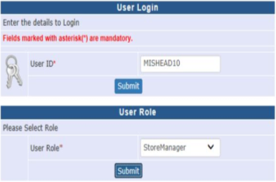
User Login
Visit Global PSP Office Portal (https://embassy.passportindia.gov.in)
Enter User ID
Press Submit button
Choose User Role as ‘StoreManager’
Press Submit button

Slide 3
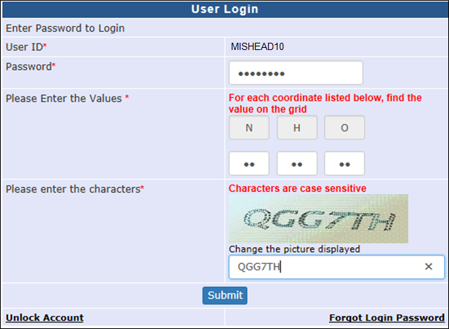
User Login (continued..)
Enter the Password
Check your User Grid and enter the values for the three alphabets displayed on the screen
Enter the characters displayed in the CAPTCHA image
Press Submit button

Slide 4
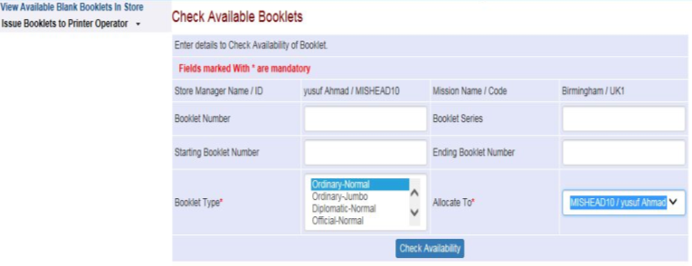
Issue Booklets To Printer Operator
Click on the Issue Booklets To Printer Operator link
Select the desired booklet type in ‘Booklet Type’ field
Select the Printer Operator to which booklets are to be assigned
Click on the ‘Check Availability’ button
Notes:
4

Slide 5
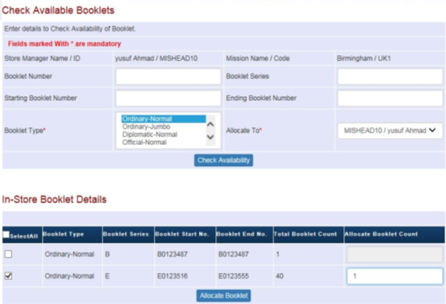
Issue Booklets To Printer Operator (Continue..)
System displays the list of blank booklets’ series available in store
Select the check-box in the desired booklet series row, specify count of booklets to be allocated in ‘Allocate Booklet Count’ column and press the ‘Allocate Booklet’ button
Notes:
5

Slide 6
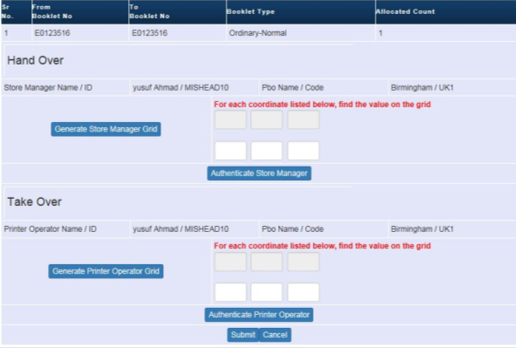
Issue Booklets To Printer Operator (Continue..)
System displays the booklet numbers identified for allocation basis the count specified in the ‘Allocate Booklet Count’ column in the ‘Hand Over – Take Over’ pane (wherein the Store Manager user is to authenticate himself/herself in Hand Over part and the Printer Operator user is to authenticate himself/herself in Take Over part in order to complete the Displayed Booklets’ Hand Over-Take Over process)
Notes:
6

Slide 7
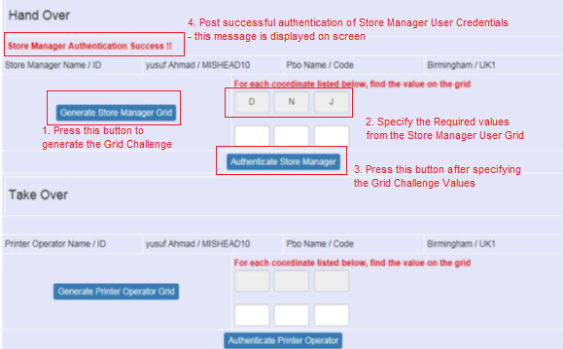
Issue Booklets To Printer Operator (Continue..)
In the Hand Over sub-pane - Store Manager user is to press ‘Generate Store Manager Grid’ button, specify the values demanded in the User Grid Challenge, and press ‘Authenticate Store Manager’ button to authenticate himself/herself
Notes:
7

Slide 8
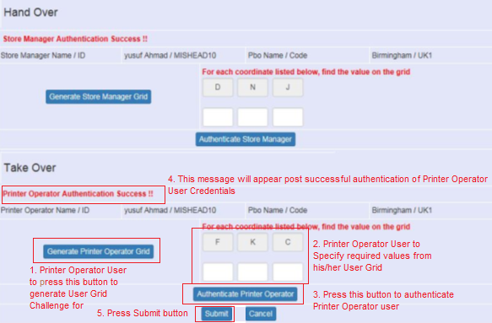
Issue Booklets To Printer Operator (Continue..)
In the Take Over sub-pane – Printer Operator user is to press ‘Generate Printer Operator Grid’ button, specify the values demanded in the User Grid Challenge, and press ‘Authenticate Printer Operator’ button to authenticate himself/herself.
Press Submit button after successful authentication
Notes:
8

Slide 9
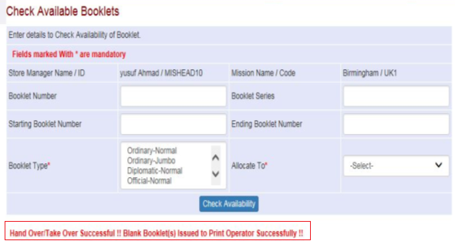
Issue Booklets To Printer Operator (Continue..)
Confirmation message is displayed post successful completion of the Blank Booklets Hand Over – Take Over process
The booklets are removed from store (no longer visible as available therein) and displayed as allocated to respective Printer Operator in the Print Passport screen (i.e. enabled for Passport/IC/EC printing)
Notes:
9

Slide 10
In case of additional information or clarification, please contact Global PSP Support Team at
Email : global.psp@tcs.com
Phone : +91-0120-672-9595/96
Mobile : +91-730-351-9595
Thank You

